Slide 1
Cruise and Park
By: Mark, Garav & Riyazh
Web Programming - Final Project

Slide 2
User
Problem: A combination website to book a cruise and parking.
Input: Login or Register, and then start picking what cruise package, room, parking, etc.
Output: After payment, a confirmation of the cruise and parking.

Slide 3
Design
Please see our website, or rewind back to our demo of our website.

Slide 4
XML
Home
Register
Login
Inventory/Destinations
Rooms
Parking
Lot Selection
Payment
Purchases
Options
Congrats

Slide 5
Code/Languages
PHP
HTML
CSS
SQL
JavaScript
Regular Expressions
Jquery
Bootstrap
Cookies

Slide 6
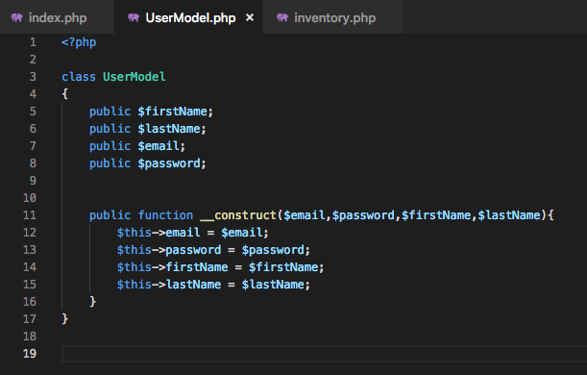
Code Snippets - Model (MVC)

Slide 7
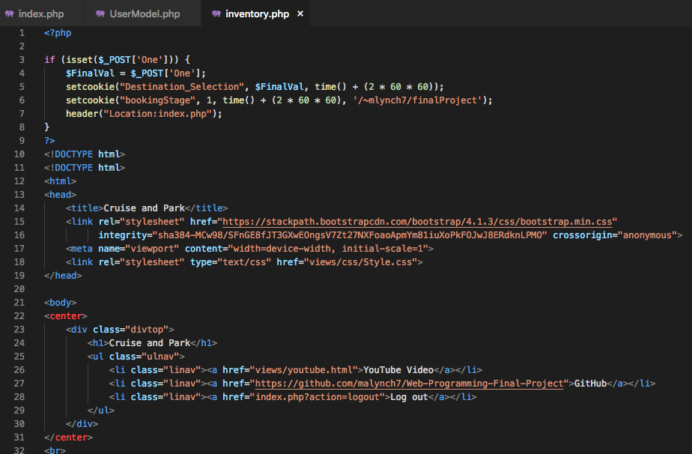
Code Snippets - View (MVC)

Slide 8
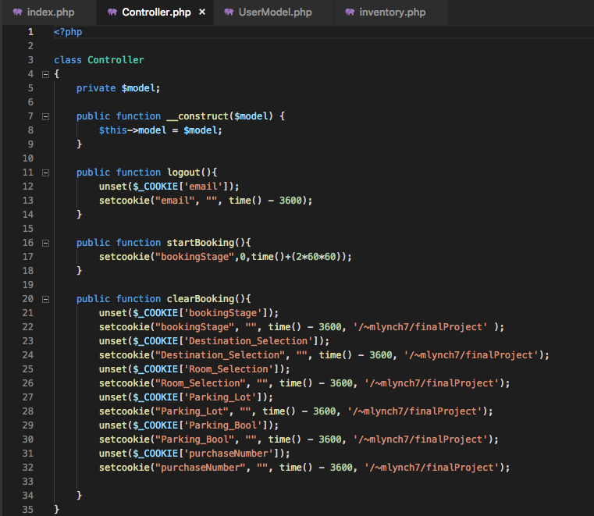
Code Snippets - Controller (MVC)

Slide 9

Testing
Testing was done manually. Lots of refreshing to adjust the looks of the pages. Also, adding mock data in our database and in our website to try out the different use cases, to see if everything is functional. More testing will be needed when we get advance with our cruise and pay website.

Slide 10
Additional Features Coming Soon
More animation
Make it more automated and user-friendly
Offer more inventory options for cruise packages, rooms and parking

Slide 11
Questions?
If you have any questions, feel free to comment below.

